Slide 1

Secure Bank Mobile Check Deposit- Benefits Analysis
February 14, 2025

Slide 2
Agenda
Overview of the Project
Tangible Benefits
Intangible Benefits
Alignment
Conclusion & Way Forward

Slide 3

Overview of the Project
Secure Bank is implementing mobile check deposit feature as a part of Digital Transformation Project.
Objective: Enhance customer satisfaction, improve operational efficiency, and maintain a competitive edge.

Slide 4
Tangible Benefits - Operational Efficiency & Cost Saving
Streamlined Processes
Reduced Branch Workload
Lower Processing Costs
Automation Reduces Manual handling, supporting KPI on average processing time (Target: 2 hrs ; Actual : 1.8 hrs)
Fewer in-branch deposits lower staff workload (Target: 20%;
Actual: 18% - improvement
opportunity).
Digital check handling cuts paper-based processing expenses (Target: $1M savings vs. Actual: $950K)

Slide 5

Tangible Benefits – Financial Gains
Faster Funds Availability: Deposits clear in 1–3 business days, boosting cash flow for customers and the bank.
Revenue Increases: Attracts tech-savvy customers, increasing digital banking revenue (Target: $5M/year; Actual: $4.8M/year).

Slide 6
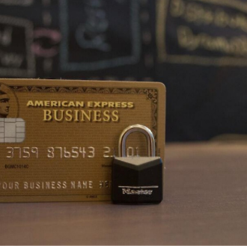
Tangible Benefits – Risk Mitigation and Compliance
Enhanced Security Measures: Fraud detection & image recognition minimize fraud risk (Security incidents: Target 0 vs. Actual 1).
Improved Compliance: Digital processes enhance adherence to regulatory standards (Target compliance: 100%; Actual: 95%).

Slide 7

Intangible Benefits – Enhanced Customer Experience
Convenience & Accessibility: Customers can deposit checks anytime, anywhere, improving the banking experience.
Improved Trust: A secure, user-friendly process enhances brand loyalty and customer confidence (e.g., boosts Net Promoter Score).

Slide 8
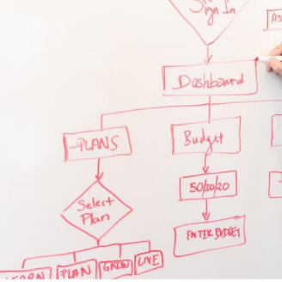
Intangible Benefits – Competitive Advantage & Market Position
Innovation Leadership: Differentiates SecureBank as an innovative, tech-forward institution.
Long-Term Strategic Value: Enhances market position and opens new revenue opportunities.
Brand Reputation: Positive customer experiences elevate the bank’s image.

Slide 9

Intangible Benefits – Internal Collaboration & Employee Morale
Empowered Workforce: Cross-functional collaboration leads to better decision-making and teamwork.
Employee Satisfaction: Reduced manual tasks free up staff to focus on high-value work.

Slide 10

Alignment with Requirements
Tangible benefits (cost savings, faster deposits, revenue growth) directly support strategic KPIs.
Improved efficiency and enhanced security address integration and operational concerns.
Better user experience and quicker service drive higher adoption and satisfaction.
Strengthened compliance and fraud prevention meet legal standards.

Slide 11

Questions ???
We are happy to take your questions.

